Slide 1
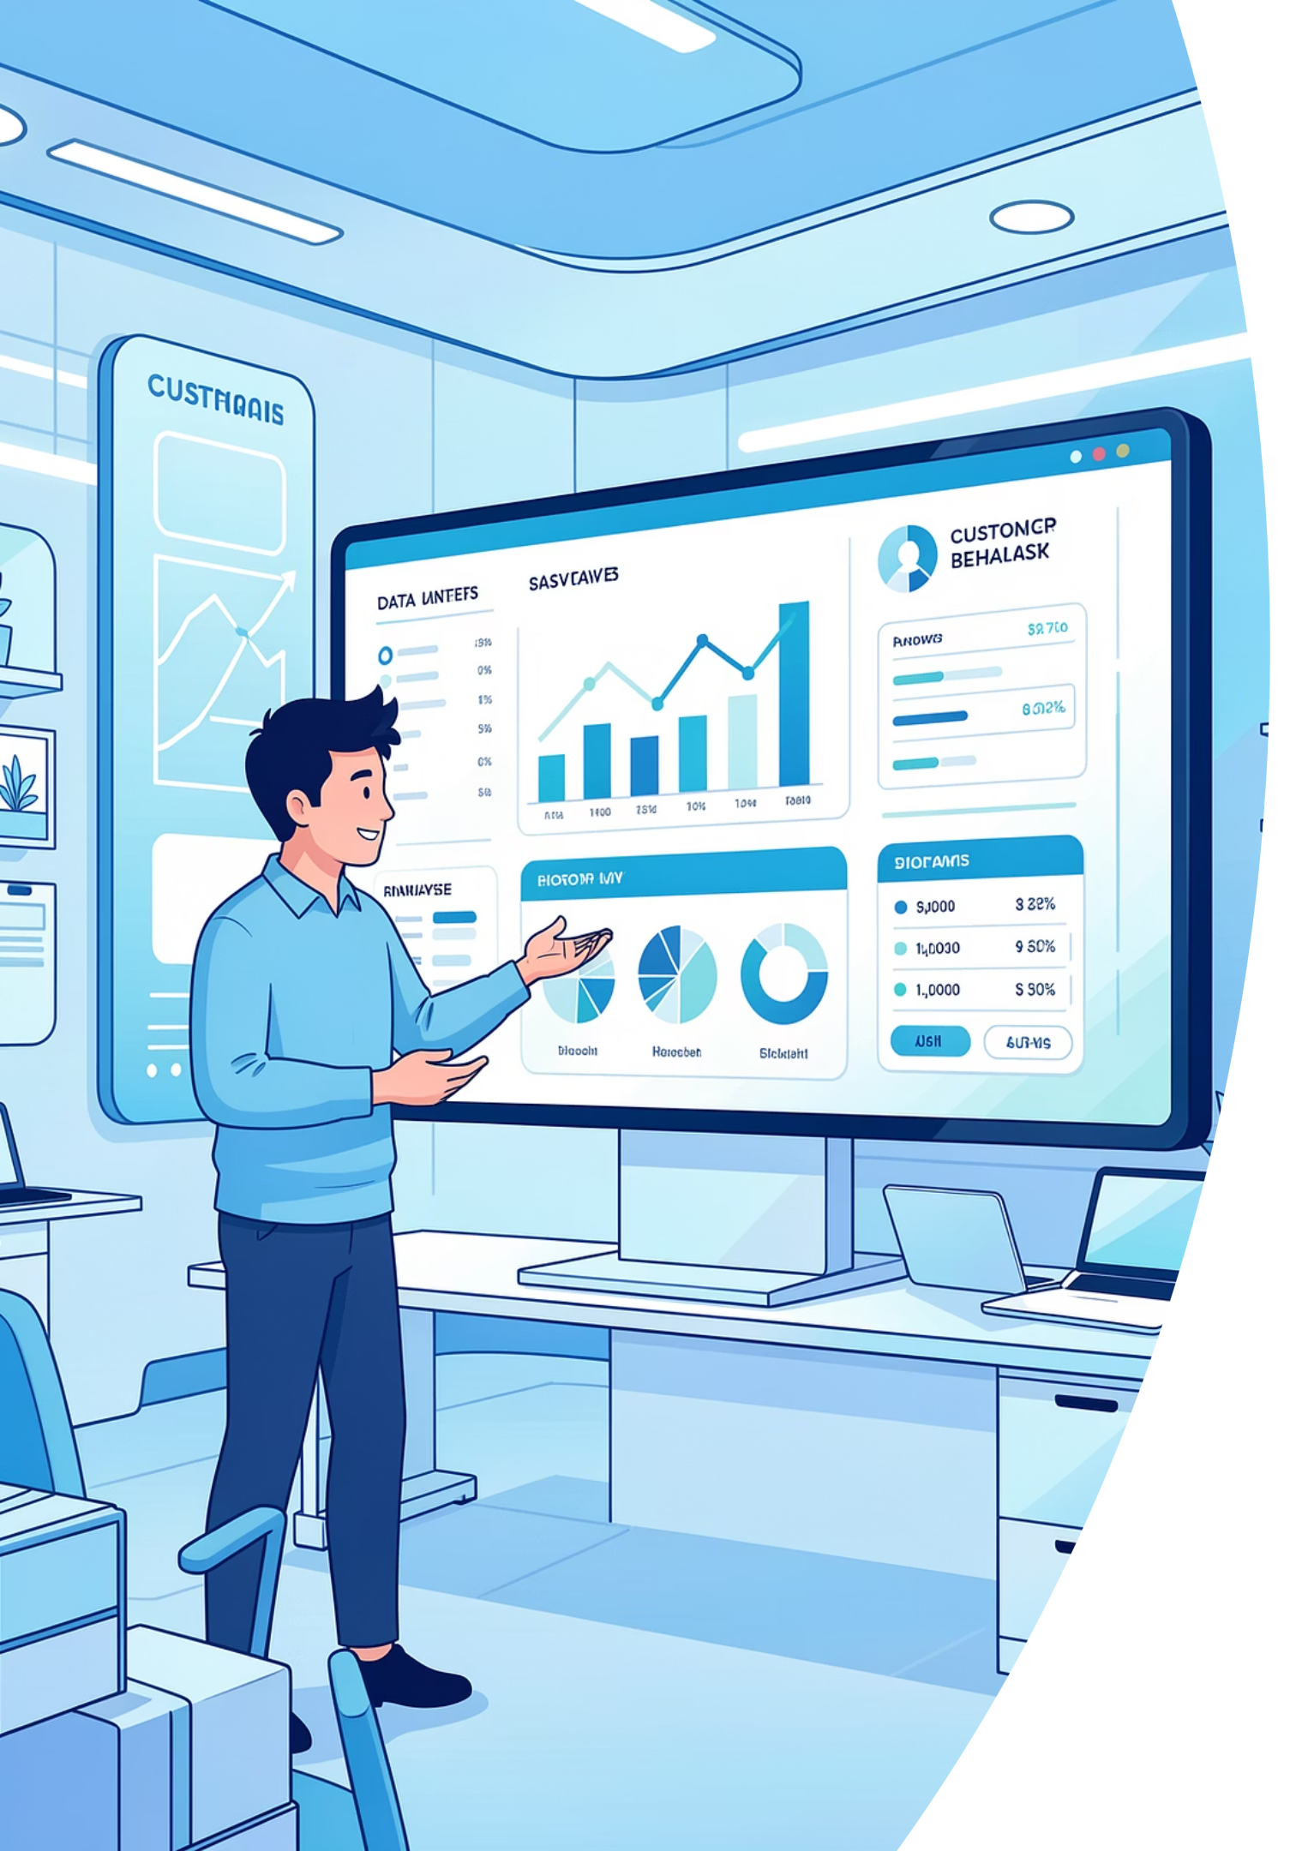
Customer Shopping Behavior Analysis
Analysis of 3,900 purchases to reveal spending patterns, segments, product preferences, subscription effects, and actionable business recommendations.

Slide 2

Dataset Snapshot
Scope
Key Features
Missing Data
3,900 rows · 18 columns covering demographics, purchases, and behavior.
Age, Gender, Location, Item, Category, Purchase Amount, Season, Review Rating, Subscription, Shipping.
37 missing values in Review Rating; handled during cleaning.

Slide 3

Data Preparation & Feature Engineering
Cleaning
Imputed Review Rating by category median; checked nulls.
Standardization
Renamed columns to snake_case for readability.
Features
Created age_group and purchase_frequency_days.
Pruning
Dropped redundant promo_code_used after consistency checks.

Slide 4
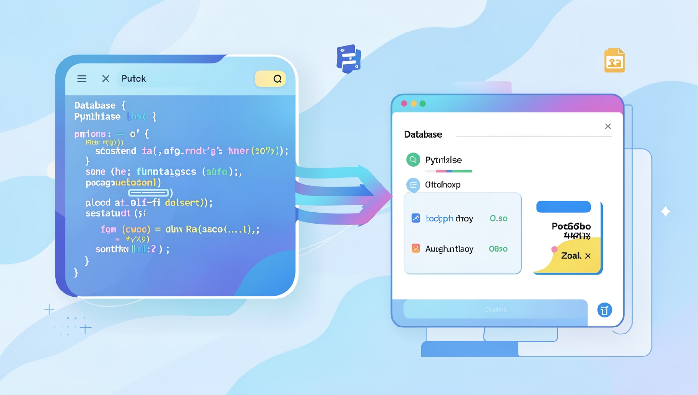
Database Integration & Workflow
Cleaned DataFrame loaded into MySQL for SQL analysis. Combined Python exploratory work with MySQL/Workbench queries to answer business questions.
Connected pipeline supports repeatable analysis and dashboarding in Power BI.

Slide 5
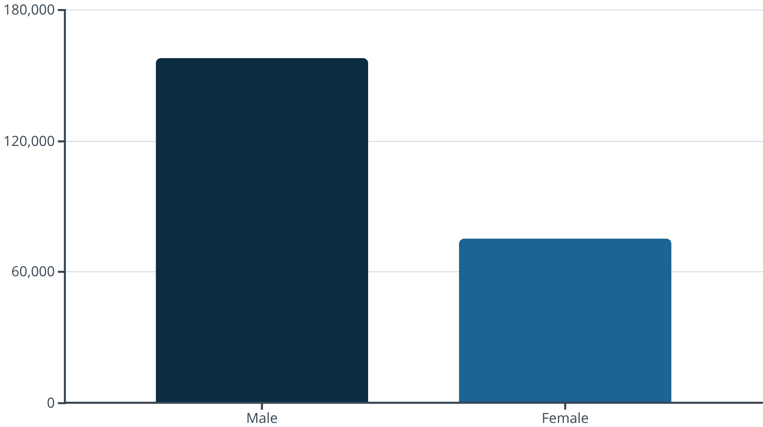
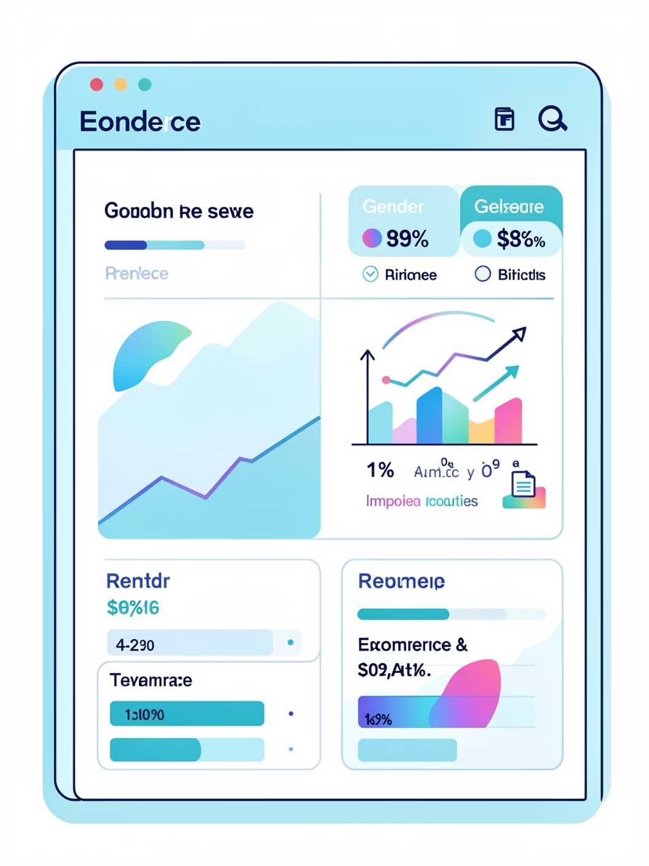
Revenue Insights
Male customers generated higher total revenue (157,890) vs. female (75,191). Use this to inform targeted promotions and product focus.

Slide 6

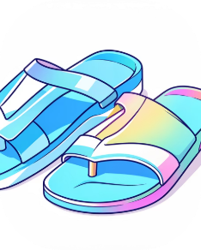
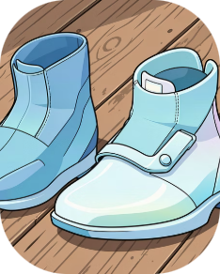

Top Products & Ratings
Gloves
Sandals
Boots
Hat
Avg rating 3.86 — top-rated product overall.
Avg rating 3.84; high in Footwear category.
Avg rating 3.82; strong performer in footwear.
Avg rating 3.80; also highest discount rate (50%).

Slide 7
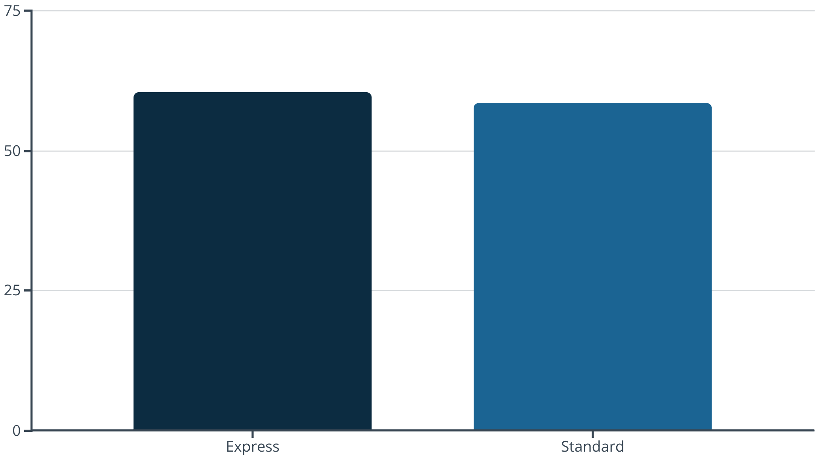
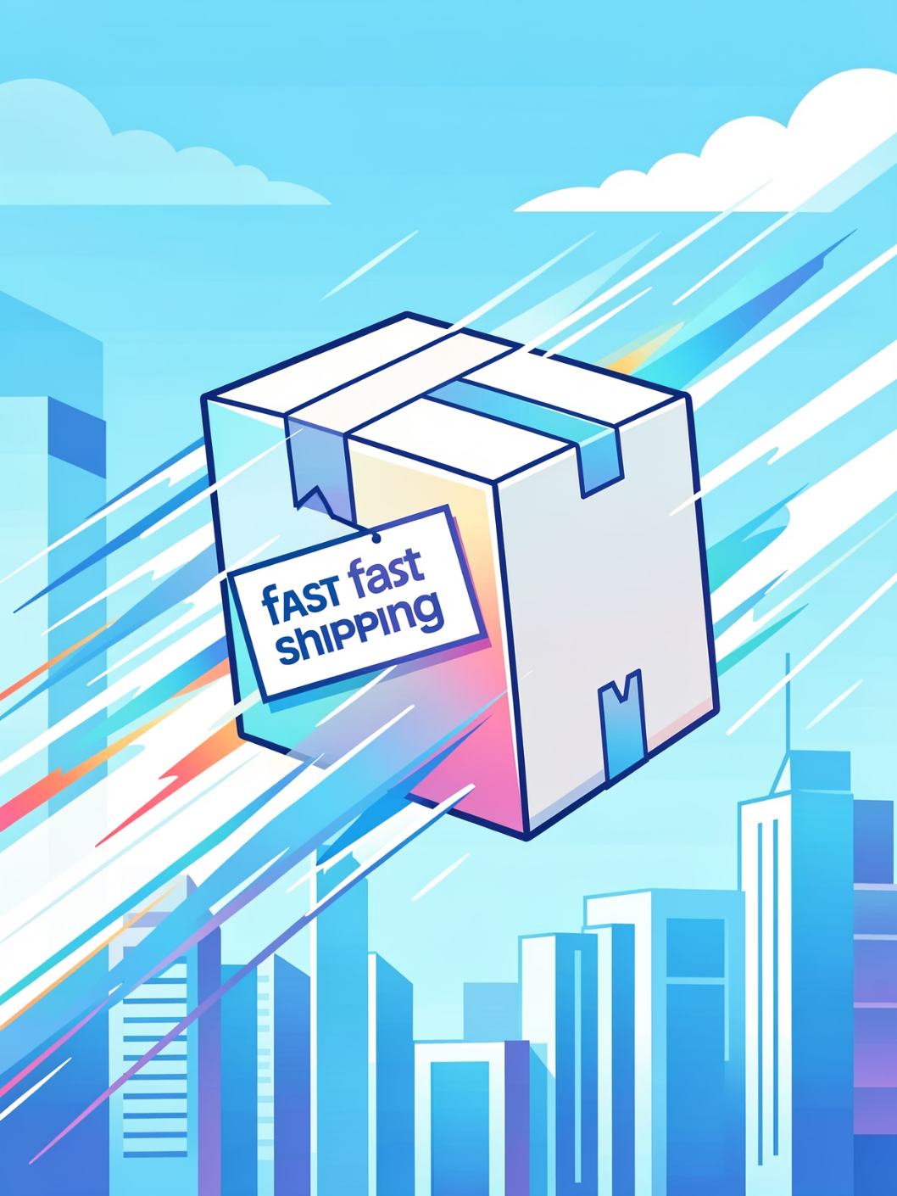
Shipping & Purchase Behavior
Express shipping users spend slightly more on average. Consider promotions tied to faster shipping to increase AOV.

Slide 8
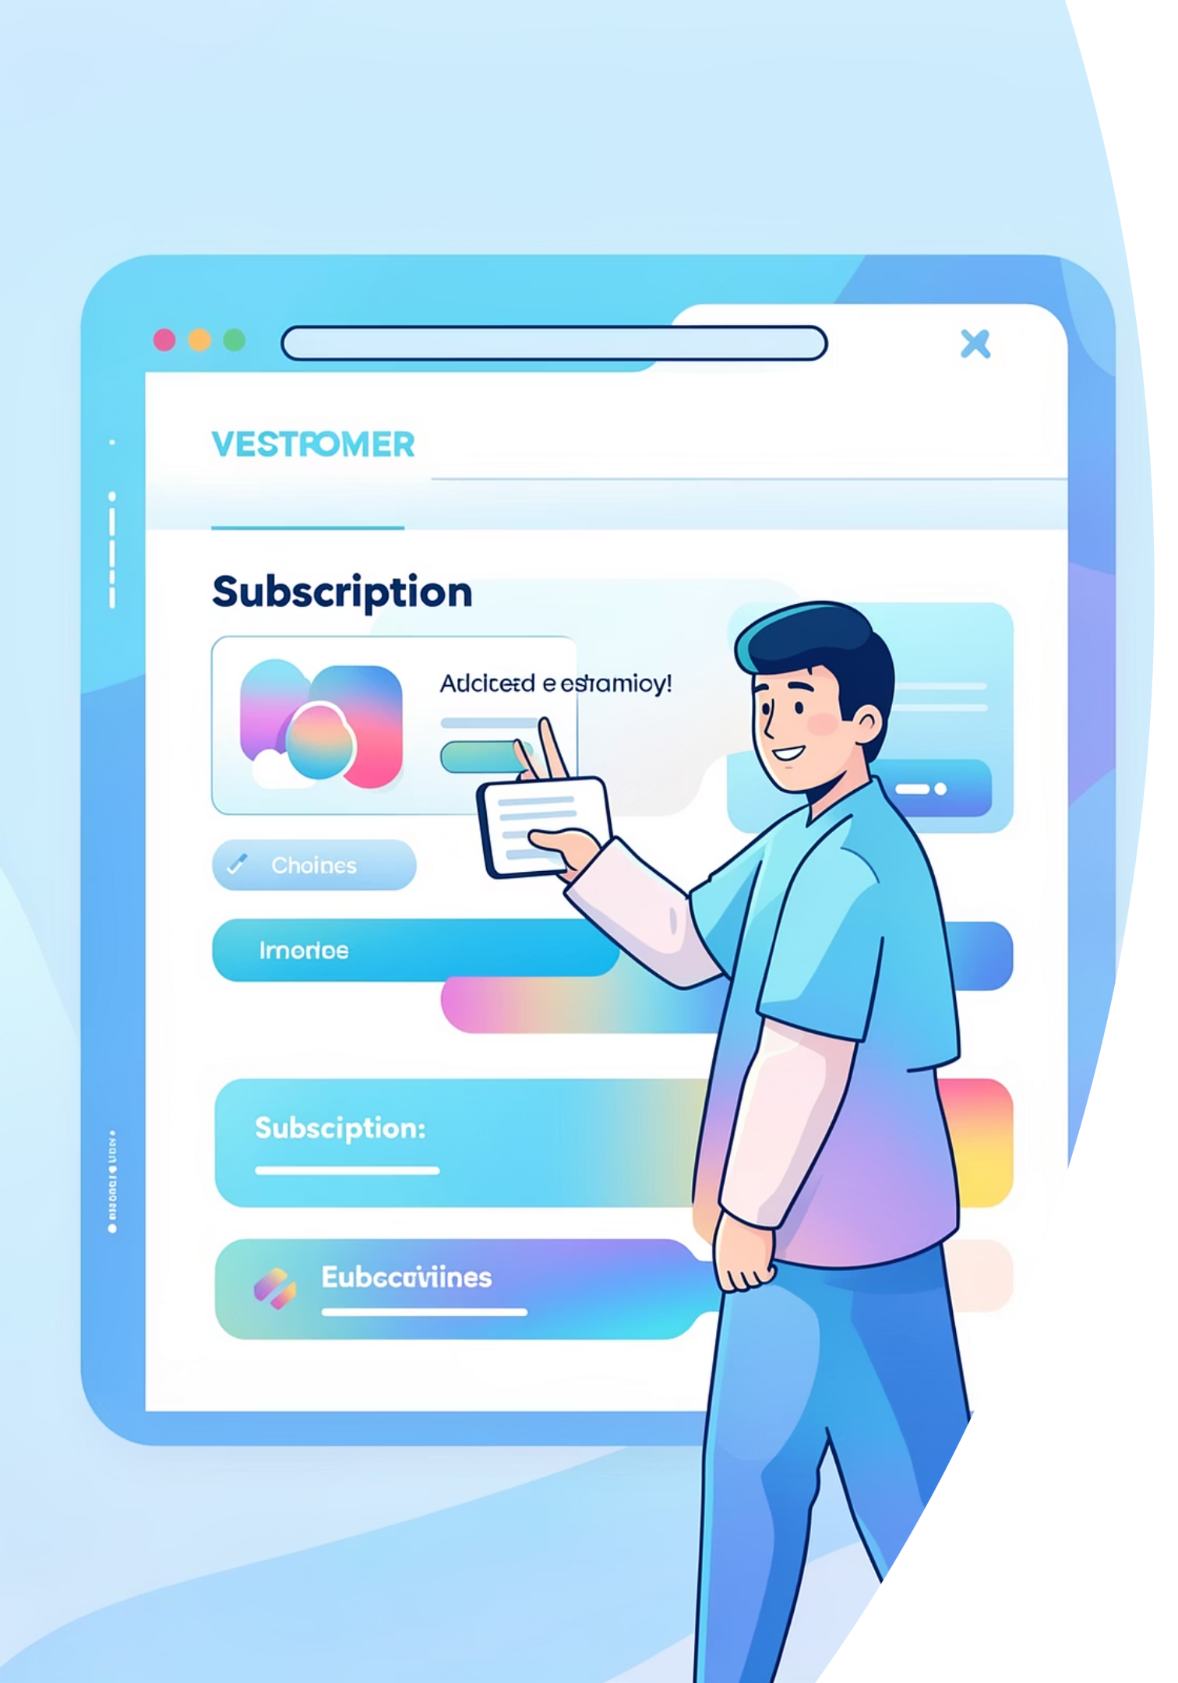
Customer Segments & Subscriptions
3.9K
$59.76
3.75
Customers
Avg Purchase
Avg Rating
Total records analyzed
Average order amount across dataset
Average review rating
Subscription breakdown: Yes 27% · No 73%. Subscriber metrics: 1,053 subscribers (avg spend 59.49, total revenue 62,645) vs. non-subscribers (2,847 customers, avg 59.87, total 170,436).

Slide 9
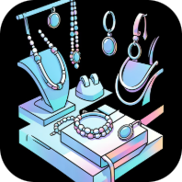

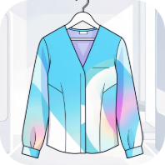
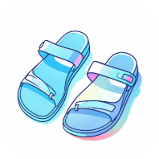
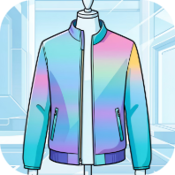
Segmentation & Top Categories
Accessories
Top items: Jewelry (171), Sunglasses (161), Belt (161).
Loyal - 3116
Returning - 701
Clothing
Top items: Blouse (171), Pants (171), Shirt (169).
New - 83
Footwear
Top items: Sandals (160), Shoes (150), Sneakers (145).
Segmentation shows dominant Loyal group (3,116). Focus retention strategies on Returning and New to grow loyalty.
Outerwear
Top items: Jacket (163), Coat (161).

Slide 10
Recommendations & Dashboard
Boost Subscriptions
Loyalty Programs
Review Discount Policy
Targeted Marketing
Reward repeat buyers to move more customers into the Loyal segment.
Focus campaigns on high-revenue age groups and express-shipping users.
Promote exclusive benefits to increase conversion among repeat buyers.
Balance discount-driven sales (e.g., Hat 50%) with margin preservation.
Product Positioning
Highlight top-rated and best-selling items across channels.
Interactive Power BI dashboard visualizes these insights and supports executive decisions.

